Slide 2
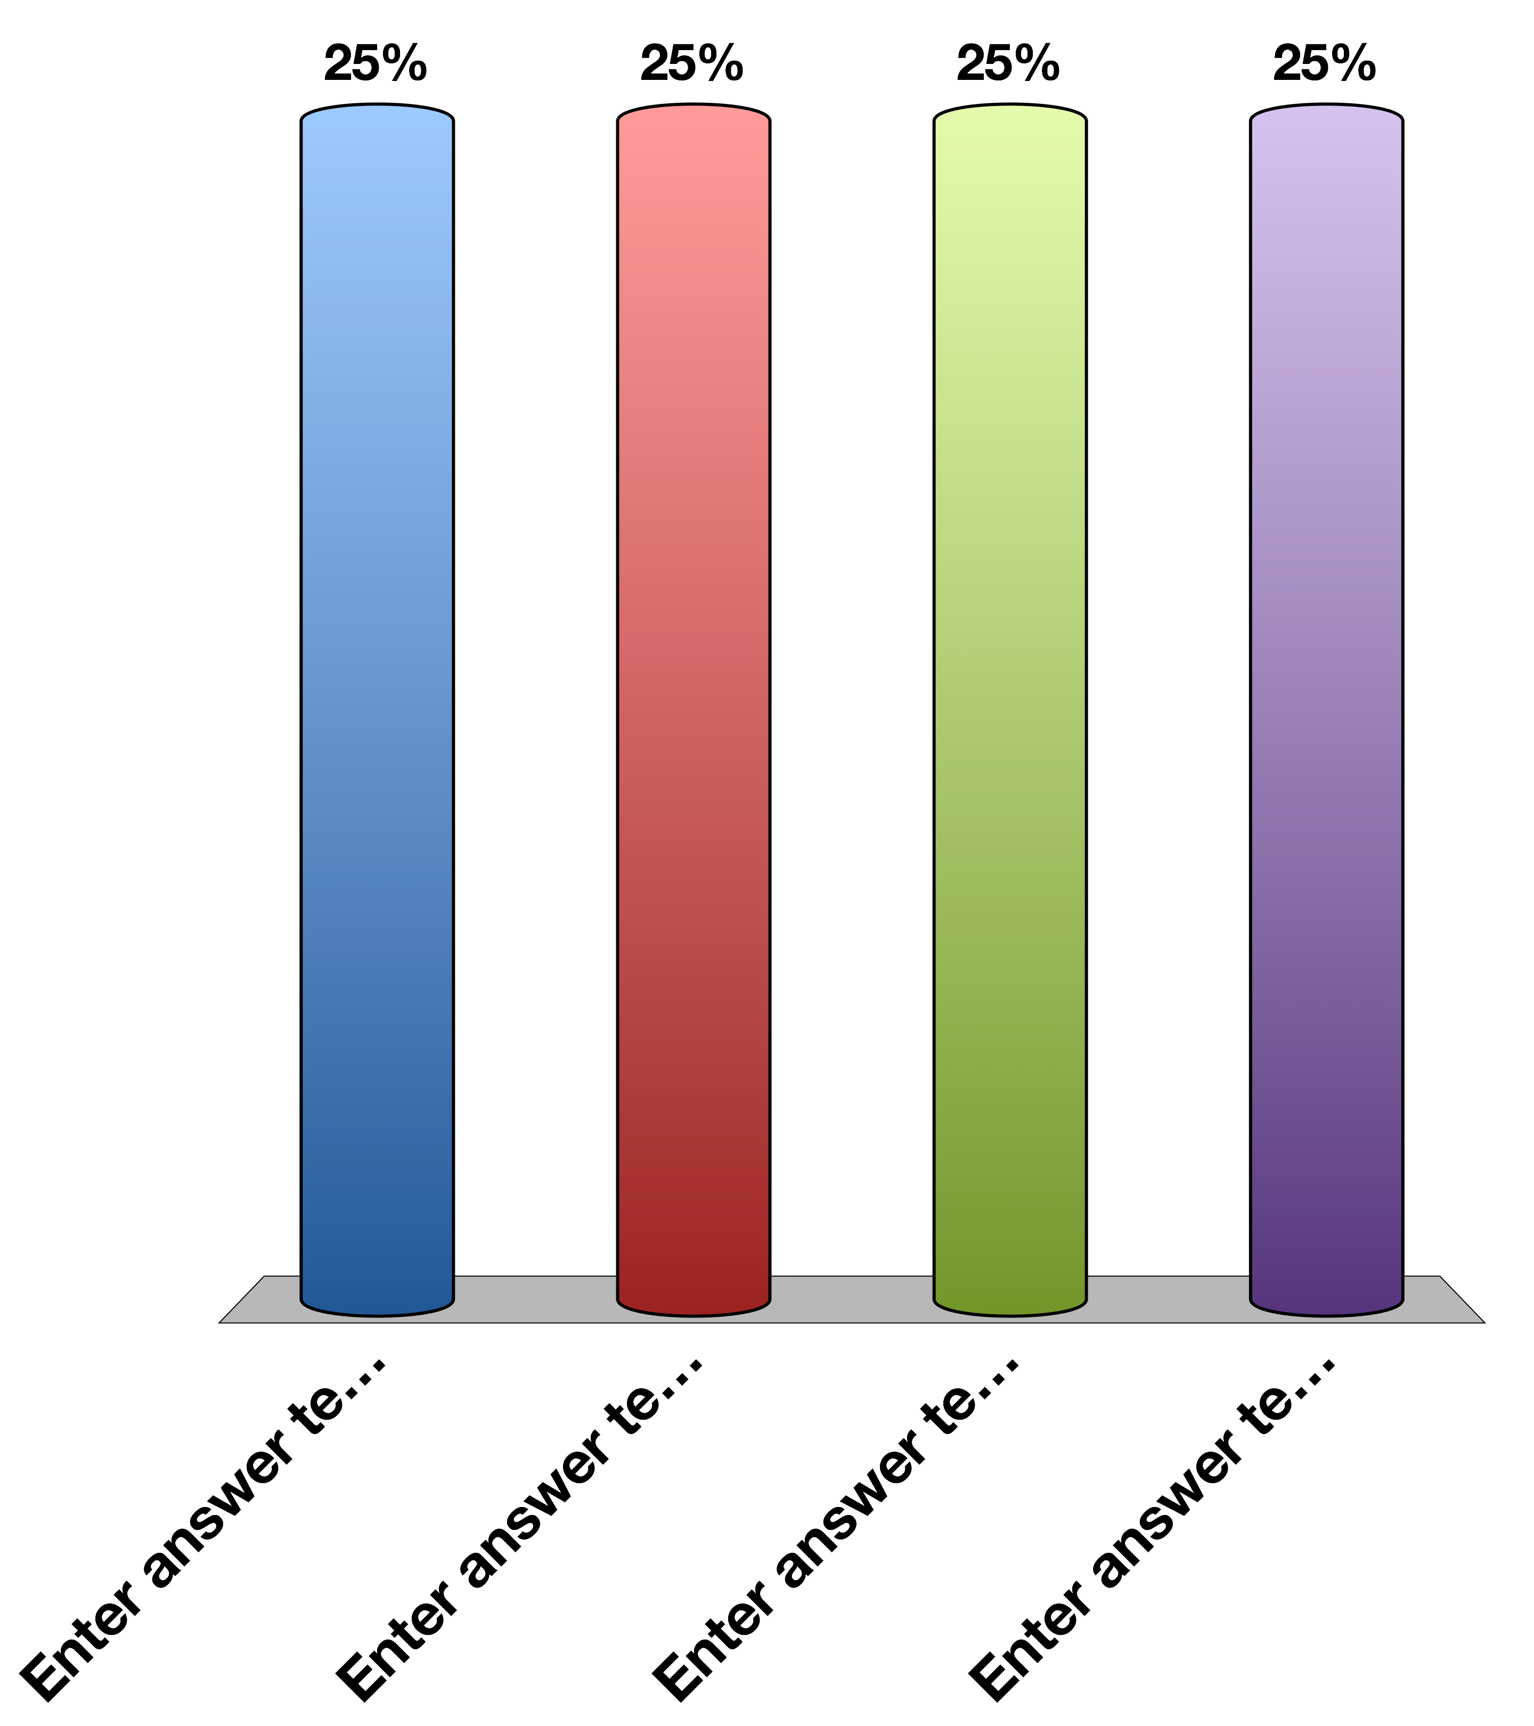
Clicker Check: Press A
A
B
C
D

Slide 3
A patient has a pheochromocytoma, treated with a beta blocker. We expect that this drug should alleviate the patient’s:
Tachycardia
GI tract smooth muscle cell vasodilation
Reduced lipolysis
All of the above

